Slide 1
Retail Relay Homework 2
Group 2 – Mar653 Marketing Analytics
JAY aTKINS, nICHOLAS lICHTSINN, aLEX nOONAN, gAVIN sCOTT, jENNIFER yANCIE

Slide 2
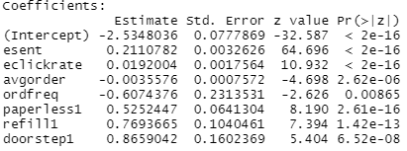
Model 1
Equation:
retained = esent + eclickrate + avgorder + ordfreq + paperless + refill + doorstep
Confusion Matrix
 | Predicted Not Retained | Predicted Retain
Actual Not Retained | 1072 | 215
Actual Retain | 157 | 4778
Hit Rate: 94.02
Recall: 96.81
True Negative Rate: 83.29
Precision: 95.69
F Score: 0.96

Slide 3
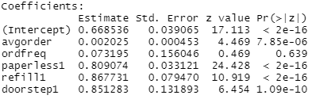
Model 2
Equation:
retained = avgorder + ordfreq + paperless + refill + doorstep
Confusion Matrix
 | Predicted Not Retained | Predicted Retain
Actual Not Retained | 0 | 1287
Actual Retain | 0 | 4935
Model Stats
Hit Rate 79%. However, Model always predicted retained.

Slide 4

Model 3
Equation: Retained = Esent
Confusion Matrix
 | Predicted Not Retained | Predicted Retain
Actual Not Retained | 1092 | 195
Actual Retain | 272 | 4663
Model Stats
Hit Rate: 92.49
Recall: 94.48
True Negative Rate: 84.84
Precision: 95.98
F Score: 0.95

Slide 5
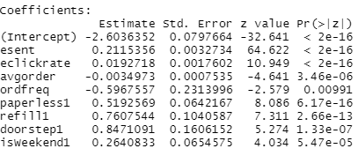
Model 4
Equation:
retained = esent + eclickrate + avgorder + ordfreq + paperless +
refill + doorstep + isWeekend
Confusion Matrix
 | Predicted Not Retained | Predicted Retain
Actual Not Retained | 1072 | 215
Actual Retain | 152 | 4783
Model Stats
Hit Rate: 94.10
Recall: 96.92
True Negative Rate: 83.29
Precision: 95.69
F Score: 0.96

Slide 6
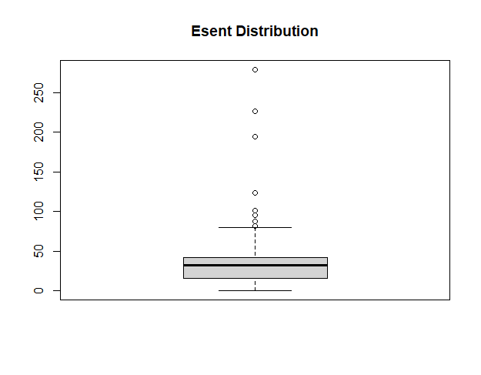
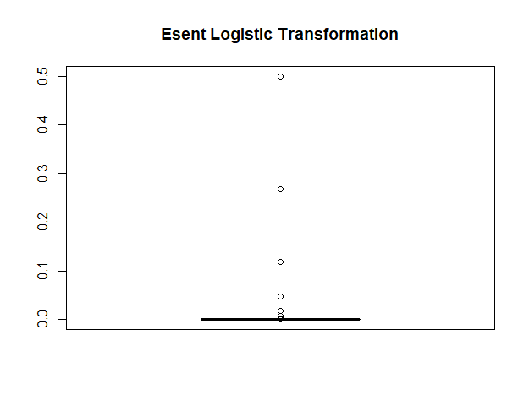
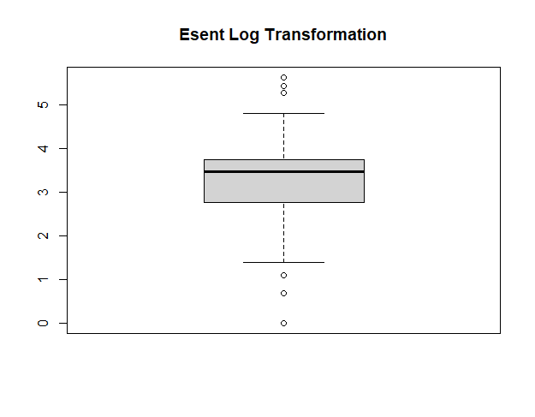
Question 5
Why is esent a strong predictor of retention?
There is a good chance that clients who have signed up for email will return to shop more
Do you see any issues with using esent as a predictor for retention?
Yes. There is an obvious notion that sending more emails will attract more customers, but it will only create frustration which will cause customers to mark the emails as SPAM.
Recommend transformations of esent that can overcome the issues of using esent as a predictor
I would recommend using eopenrate or eclickrate. Those individuals are interacting with the emails that are being sent.
Notes:
Esent is a strong predictor of retention because customers who have signed up to receive emails are more likely to shop at the store
Using the coefficient you could assume that more emails sent would make a customer more likely to be retained but that is not the case. More emails does not equal more retention and most customers would not want to get 500 emails from their grocer. Using eopenrate or eclickrate would have a more quantifiable coefficient because those people are interacting with the emails that are being sent.

Slide 7
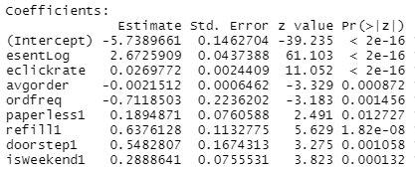
Model With Transformed Esent Variable
Equation:
retained = esentLog + eclickrate + avgorder + ordfreq + paperless +
refill + doorstep + isWeekend
Confusion Matrix
 | Predicted Not Retained | Predicted Retain
Actual Not Retained | 1034 | 253
Actual Retain | 86 | 4849
Model Stats
Hit Rate: 94.5516
Recall: 98.2573
True Negative Rate: 80.3419
Precision: 95.0412
F Score: 0.9662

Slide 8
Question 6
Does the sign of the coefficients for avgorder, ordfreq, and weekend make sense?
Avgorder = -0.0021512 (Negative)
Ordfreq = -0.7118503 (Negative)
Weekend = 0.2888641 (Positive)
What consumer behavior explanation can you provide for the sign of these coefficients?
Customers are more likely to not be retained if their orders are larger
Customers approaching their lifetime value are more likely not to be retained
Customers with a favorite delivery day on the weekend are more likely to be retained because they are signed up for scheduled delivery service
Notes:
Avgorder - This sign being slightly negative makes sense because if a customer has a higher average order they are more likely to go longer in-between purchases and could fall off as a customer easier.
Ordfreq - This is pretty significantly negative, and makes sense. Since the number of orders is divided by customer tenure the customer is getting more negative the more orders they have in their lifetime. This is because the customer is approaching their lifetime value, so each customer is more likely to fall off the longer they have been a customer.
Weekend - This makes sense because if a customer's favorite delivery day is the weekend they are more likely to be subscribed for delivery and more likely to be retained.

Slide 9
Question 7
What are your recommendations to Relay Foods Management for improving their customer retention?
Focus on getting customers subscribed to their services
Customers subscribed to paperless communication
Customers subscribed for doorstep delivery
Customers subscribed to automatic refill
Notes:
I would have them push to get customers to subscribe to their offerings either paperless or doorstep delivery, but automatic refill as a service is the largest coefficient to retain customers so they should advertise and push customers to sign up for automatic refills either with discounts or other incentives to retain as many customers as possible.

